Slide 1


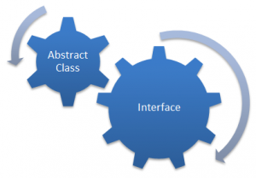



Slide 2


AAP CHRONOLOGY SAMAJHIYE
Phle User Requirement ayegi
Phir developer code banayega
Phir developer ko restriction deni hogi user ko
Phir developer user interface banayega
Phir security ka issue ayega
Phir developer data hide krega
Aur phir ayega abstract class aur interface

Slide 3


Slide 4


Slide 5
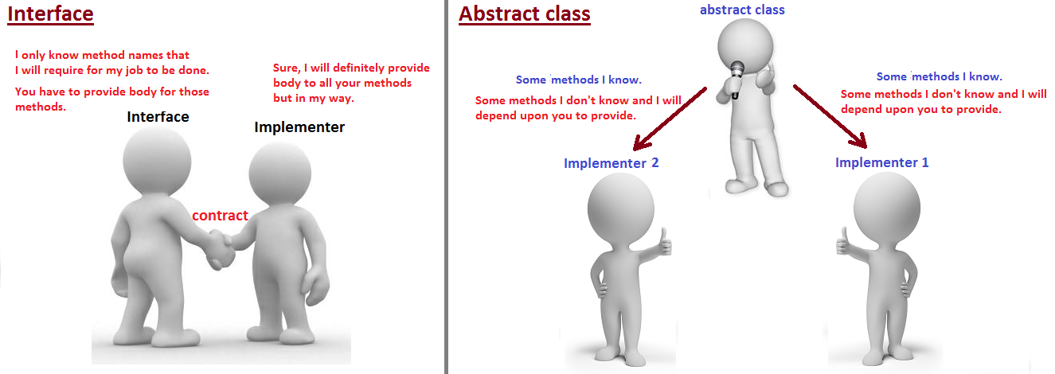

Slide 6
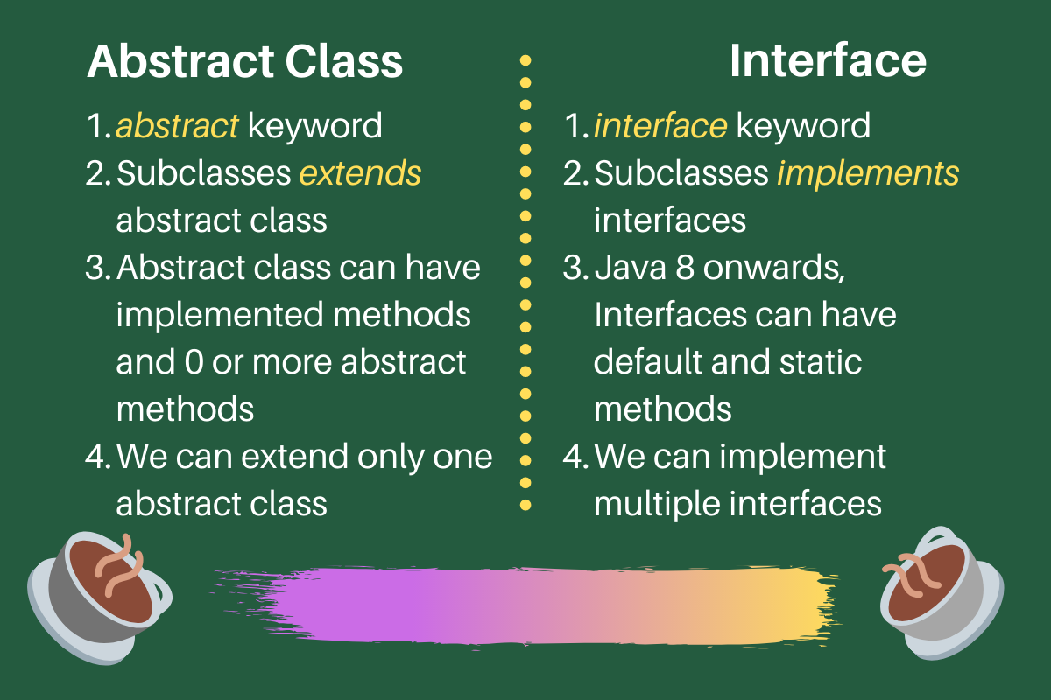

Slide 7
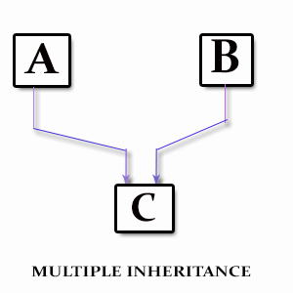

Slide 8



